Slide 1

FIFA 2019 Player Data
Exploring Players Statistics and Build Your Dream Team
Analytics Framework and Methods II
Yufan Luo, Yu Yang, Suzy Gao, Zhijun Liu
Notes:
Good morning everyone, we are the research team for FIFA 19.(下一张ppt)FIFA19 is a soccer simulation video game developed by EA and released last year. In this game, managers can hire characters to build their dream teams for all season games. The dataset is based on real world data and have more than 100 variables for more than 18000 players. The dataset contains information such as players name, nationality, wage, scores for each position, scores for each skill and so on. We want to use the dataset to do the following tasks: data visualization, position predictive model, and replacement model. (下一张PPT 到我苏)

Slide 2
Agenda
Introduction and Statement of Problem
Player EDA and Visualization
Models and Analytical Techniques
Conclusion and Use Case

Slide 3

Introduction
“FIFA19”, released on September 18th, 2018, is a football simulation video game developed by EA,. In “FIFA19”, we have over 100 variables and 18,000 rows.
For this dataset, we want to do the following tasks:
1)High level exploratory data analysis.
2)Build a predictive model to predict possible position for a player based on the skill sets of that player.
3)Build a replacement system. Through the system, users can find a similar replacement for a particular player.
Notes:
Good morning everyone, we are the research team for FIFA 19.(下一张ppt)FIFA19 is a soccer simulation video game developed by EA and released last year. In this game, managers can hire characters to build their dream teams for all season games. The dataset is based on real world data and have more than 100 variables for more than 18000 players. The dataset contains information such as players name, nationality, wage, scores for each position, scores for each skill and so on. We want to use the dataset to do the following tasks: data visualization, position predictive model, and replacement model. (下一张PPT 到我苏)

Slide 4
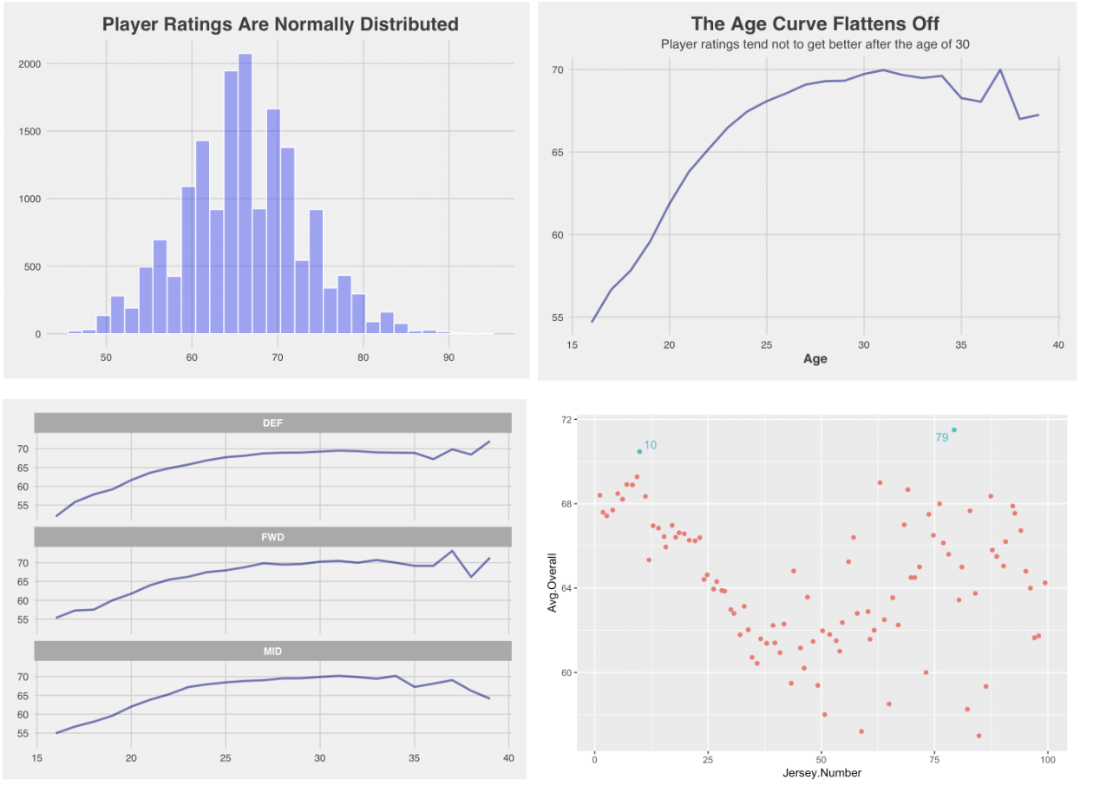
What Would Affect Player Ratings
1. Distribution of Player Ratings
2. Player Ratings vs Age
3. Player Rating vs Age (group by positions)
4. Does Jersey Number matter?
Notes:
Player ratings are normally distributed
Player ratings tend not to get better after the age of 30
Defenders’ ratings start to decline earliest at around age of 33, and the decline for both attackers and midfielders starts around 35 years of age.

Slide 5
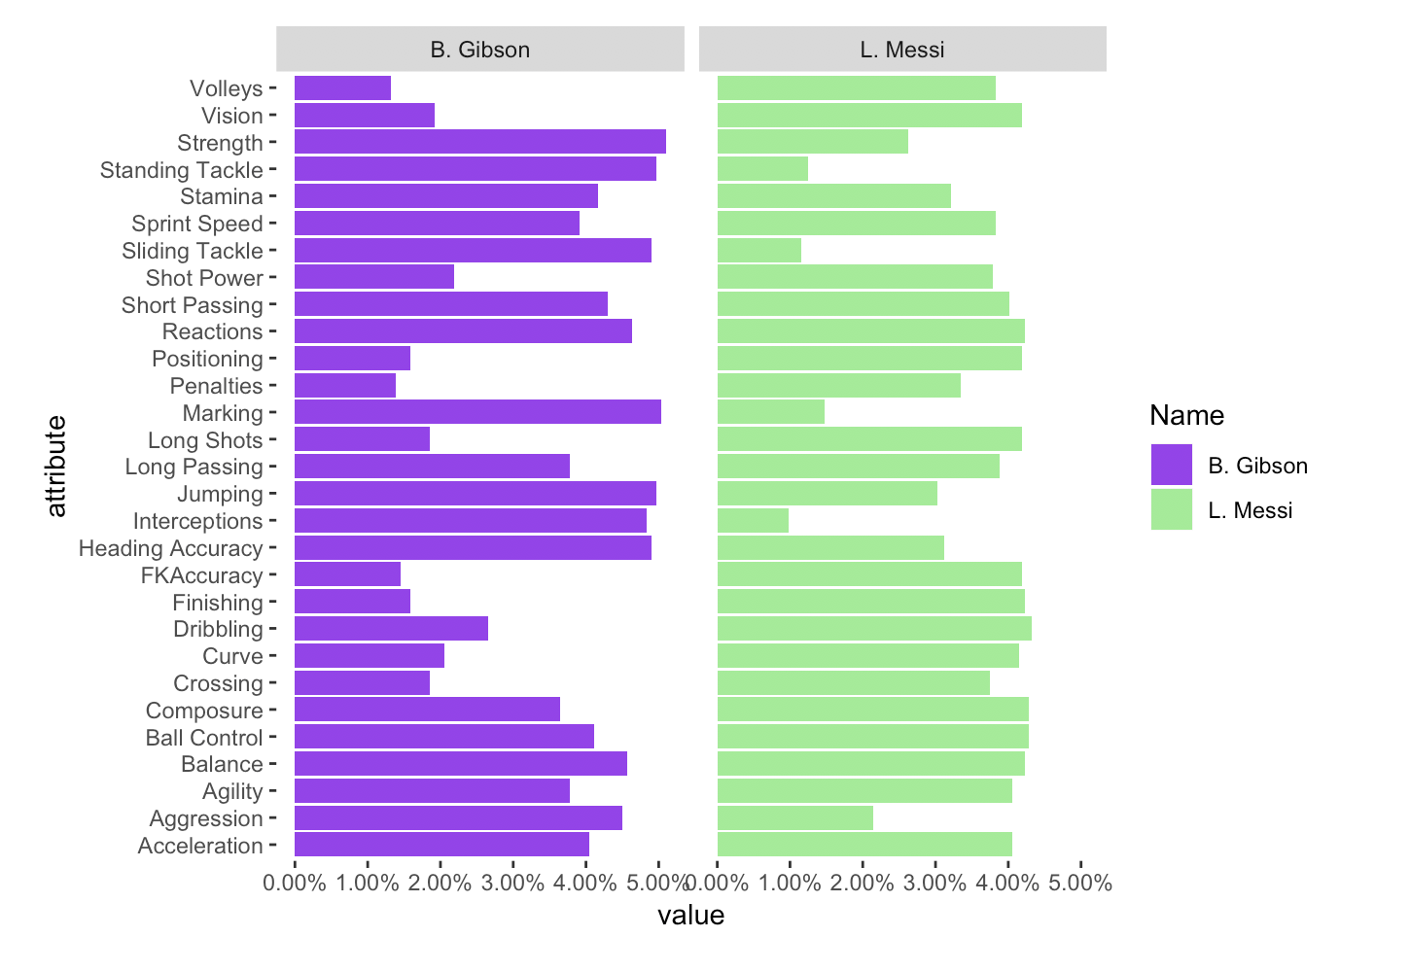
Who is going to be the next Messi
Gibson is good at Jumping, Interceptions and heading accuracy
Messi is good at finishing
Notes:
Ben Gibson has strengths in Jumping, Interceptions and heading accuracy. Whereas Messi clearly stronger at finishing.
Therefore, we realized individual strengths are key factors in determining a player's position, and we need to pay more attention to these features when we are building models.

Slide 6
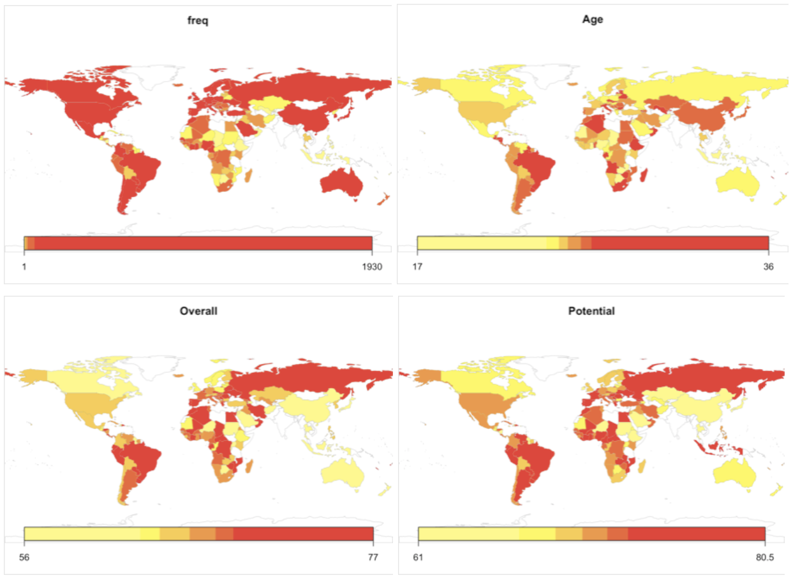
Spatial Analysis
1. Players' quantity
2. Average Age
3. Average Overall Ratings
4. Potential Ratings
Notes:
Here we drew four map plots to show players’ quantity, average age, average overall rating and average potential rating in each country.
Except Africa and West Asia, all continents have a large number of football players. The average age of players in Asia and South America is higher than players in other continents.
And players in Europe and South America tend to have higher overall and potential ratings.

Slide 7
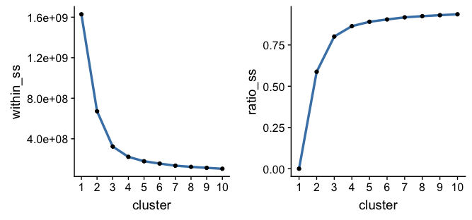
K-Means Clustering
Clustering Result
Two centers | Size
Cluster 1 | 12689
Cluster 2 | 3954
Three centers | Size
Cluster 1 | 7421
Cluster 2 | 1983
Cluster 3 | 7239

Slide 8
ML Models
 | Cluster 1 | Cluster 2 | Average | Entire dataset
Size | 12689*0.2 | 3954*0.2 | - | 16643*0.2
Random Forest | 0.8611333 | 0.97875 | 0.88907637 | 0.8848855
Neural Network | 0.8627294 | 0.98 | 0.89059024 | 0.8854962
Mixed Model | Neural Network | Neural Network | 0.89059024
Random Forest
Number of trees: 1000
Number of variables to possibly split at in each node:9
Neural Network
Input drop ratio: 0.1
Hidden layers: (10, 10, 5)
Activation function: Rectifier with dropout
Average is the weighted average of all clusters’ accuracy
0.2 is the share of observations in test set.
 | Cluster 1 | Cluster 2 | Cluster 3 | Average
Size | 7421*0.2 | 1983*0.2 | 7239*0.2 | -
Random Forest | 0.8474462 | 1 | 0.8907216 | 0.88444583
Neural Network | 0.8487903 | 1 | 0.8879725 | 0.88384941
Mixed Model | Neural Network | Neural Network/ Random Forest | Random Forest | 0.88504515

Slide 9
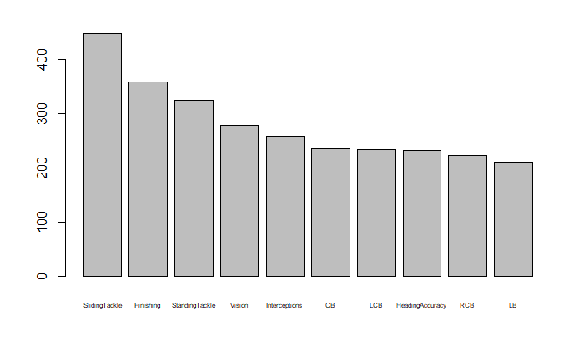
SkillSets insight & replacement recommendation
Master Sliding Tackle, Finishing, Standing Tackle, Vision, Interceptions and heading accuracy differently.

Slide 10
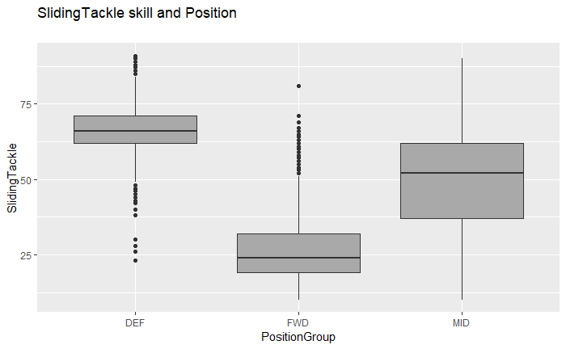
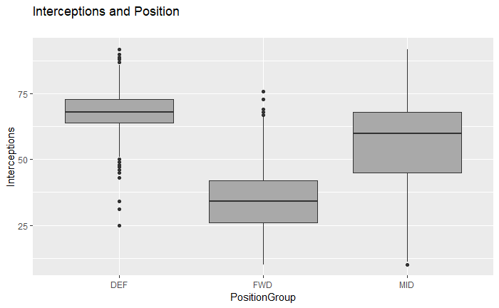
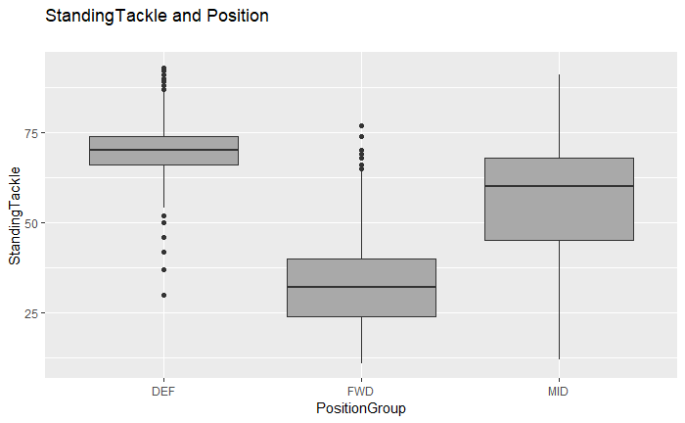
SkillSets insight & replacement recommendation
DEF players are good at sliding tackle, interception and standing tackle

Slide 11
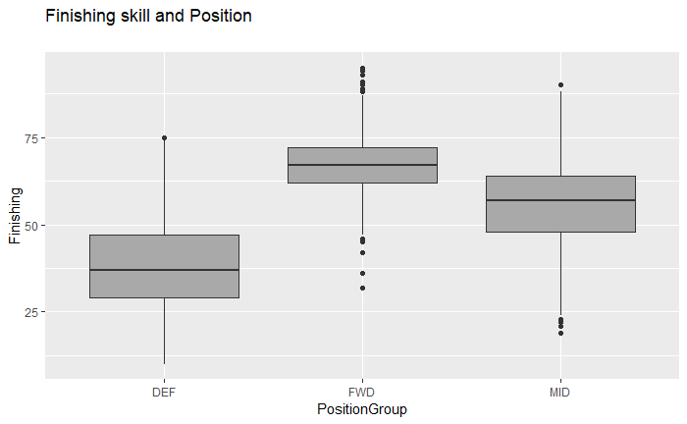
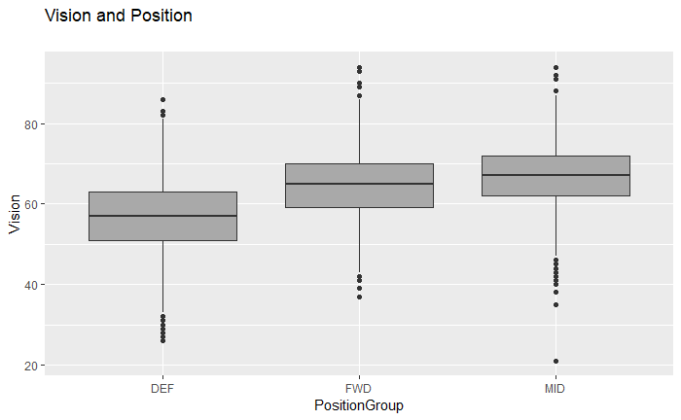
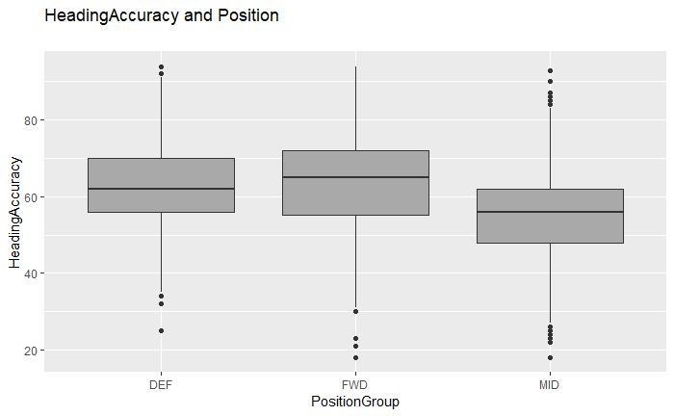
SkillSets insight & replacement recommendation
FWD players have to master skill finishing. Both DEF and FED have high heading Accuracy Midfielder has best vision.

Slide 12
SkillSets insight & replacement recommendation
replacement recommendation System:
Use players skills rating and euclidean method to calculate similarity distance
Build findsimilarplayer() function
Make replacement recommendation

Slide 13
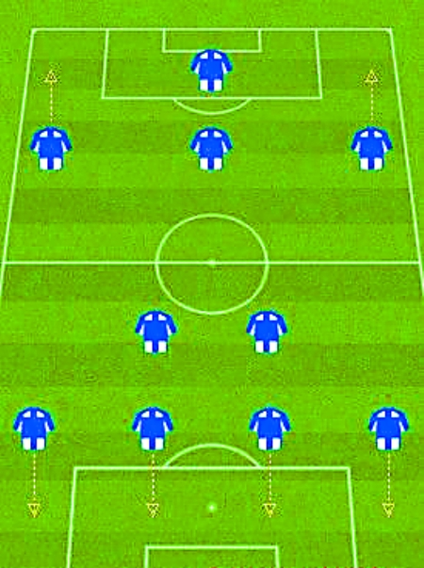
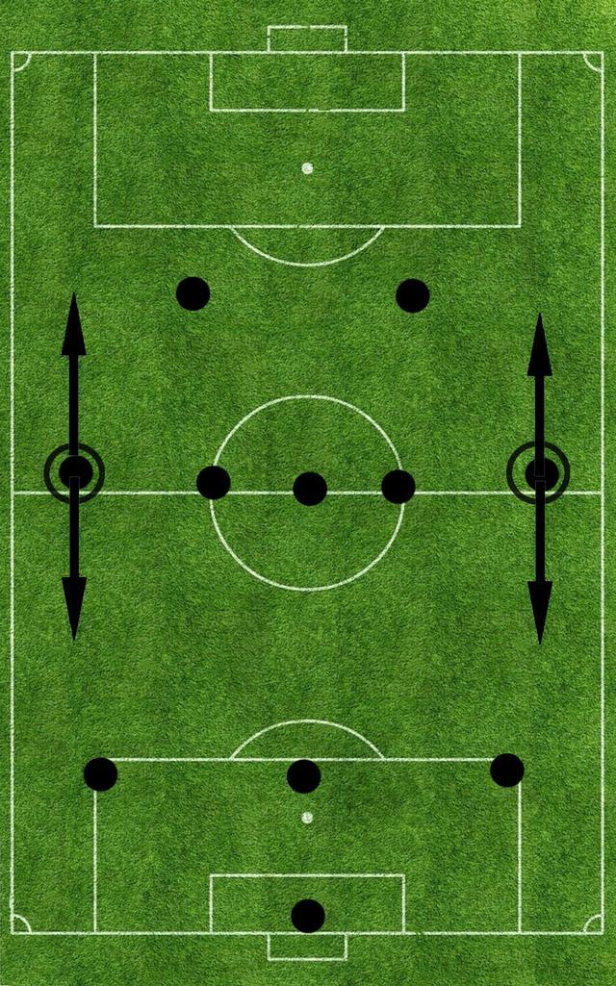
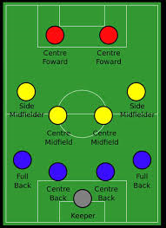
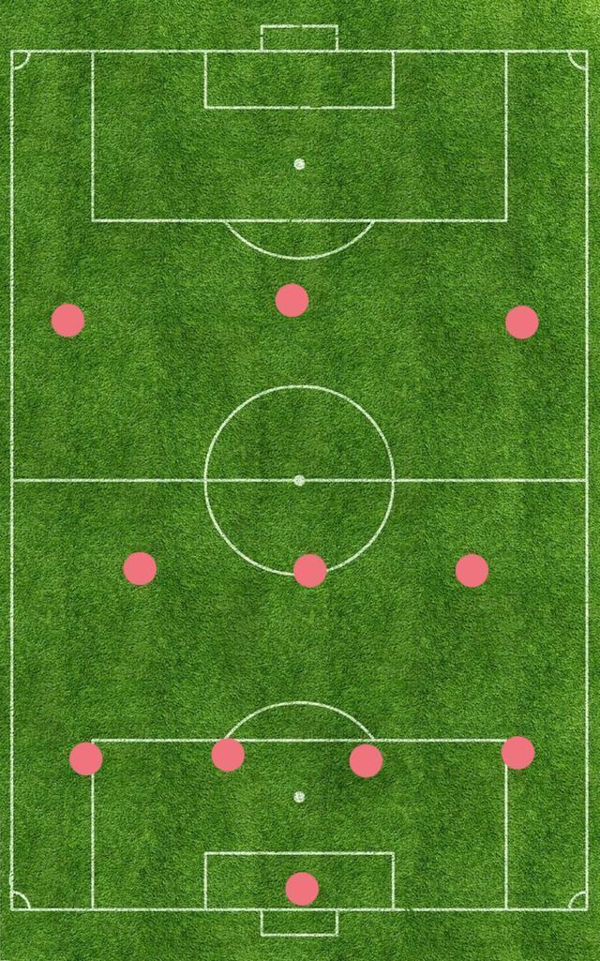
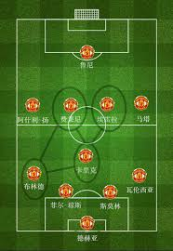
Conclusion/findings
Insights and correlations between player value, wage, age, special attributes, and performance can be derived from the visualization part.
Position predictive model serves as a reference for managers and facilitates the flexibility against the other teams.
4231
352
442
433
4141
Notes:
For the first task, we got several insights after doing the data visualizationFor the second task, we successfully built a predictive model with more than 95% accuracy. The model serves as a reference and facilitates the flexibility. For one thing, if the against teams change the positioning model, lets say from 4141 to 4231, managers can react by repositioning payers to the most appropriate position. For the other, since the players’ conditions change from time to time, our most updated models can generate the most accurate simulation and the greater chance to win.(下一张PPT)For the third task, our replacement model enables managers to find substitutes for certain players in case managers have limited budget or some players are absent. For example, if you want to hire super expensive Messi with limited budget, you can use our replacement model to find a substitute, which will be Depay in this case.We hope our reports can depict a whole picture of the current situation of soccer players. Users can understand how a player is positioned and how to find substitute for certain players. The results can be used when managers build the team, when EA designs the following games, and even when real world clubs make up their teams.

Slide 14
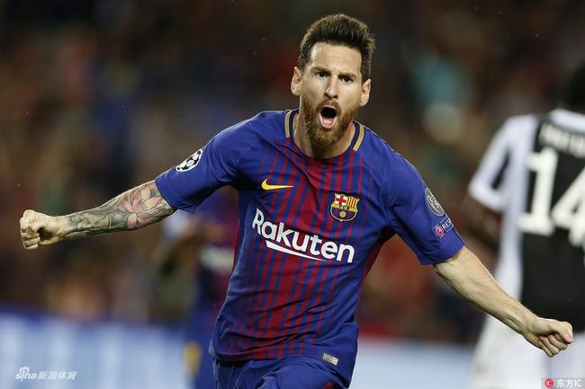
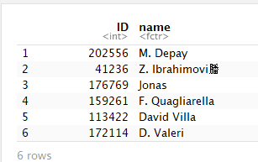
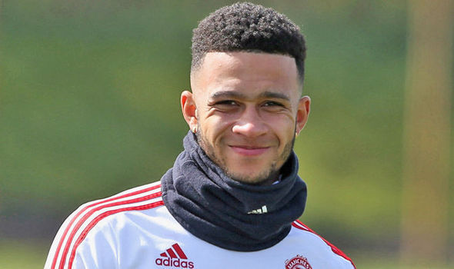
Conclusion/findings
Replacement model enables managers to find a list of bench players for certain players.
110500K
57000K
Notes:
DEF has stronger Sliding Tackle, Standing Tackle, heading accuracy and Interceptions skills. FWD has extremely high finishing skills. Midfielder are very versatile and they need to master lots of different skills.

